Slide 1
Introduction To Compiler
Course Code: CSC 3220
Course Title: Compiler Design
Dept. of Computer Science
Faculty of Science and Technology
Lecture No: | 3 | Week No: | 3 | Semester: | Fall 2024-2025
Lecturer: | Shahnaj Parvin sparvin@aiub.edu

Slide 2
Lecture Outline
Phases of a Compiler
Practice on Different Input Expressions
Linker and Loader
Front end and Back end of a compiler
Symbol Table Management
Error Handler

Slide 3
Objectives and Outcomes
Objectives:
Understand the Structure of a compiler
Understand the tools involved( Scanner generator, Parser generator, etc)
Outcome:
Students will be able to represent the simulation of all phases of a compiler for inputs.

Slide 4
The Phases of a Compiler
Source Program
1
Lexical Analyzer
2
Syntax Analyzer
3
Semantic Analyzer
Symbol-table Manager
Error Handler
4
Intermediate Code Generator
5
Code Optimizer
6
Code Generator
Target Program

Slide 5
Two main Phases of a Compiler
Analysis Phase: Breaks up a source program into constituent pieces and produces an internal representation of it called intermediate code.
Lexical Analyzer
Syntax Analyzer
Semantic Analyzer
Intermediate code generator
Synthesis Phase: Translates the intermediate code into the target program.
V. Code optimizer
VI. Code generator

Slide 6
Tokens: A Token is a pre-defined sequence of characters that cannot be broken down further. It is like an abstract symbol that represents a unit. A token can have an optional attribute value. There are different types of tokens:
Identifiers (user-defined)
Delimiters/ punctuations (;, ,, {}, etc.)
Operators (+, -, *, /, etc.)
Special symbols
Keywords
Numbers
2. Lexemes: A lexeme is a sequence of characters matched in the source program that matches the pattern of a token.
For example: (, ) are lexemes of type punctuation where punctuation is the token.
3. Patterns: A pattern is a set of rules a scanner follows to match a lexeme in the input program to identify a valid token. It is like the lexical analyzer's description of a token to validate a lexeme.
For example, the characters in the keyword are the pattern to identify a keyword. To identify an identifier the pre-defined set of rules to create an identifier is the pattern

Slide 7
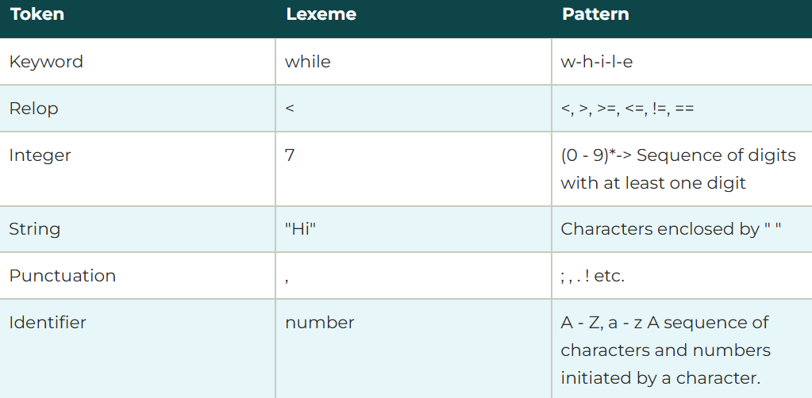

Slide 8
The Phases of a Compiler
Lexical Analyzer: The first phase of a compiler is called lexical analysis or scanning. The lexical analyzer reads the stream of characters making up the source program and groups the characters into meaningful sequences called lexemes. For each lexeme, the lexical analyzer produces as output a token of the form (token-name, attribute-value). For example, suppose a source program contains the assignment statement
p o s i t i o n = i n i t i a l + r a t e * 60
The characters in this assignment could be grouped into the following lexemes and mapped into the following tokens passed on to the syntax analyzer:
p o s i t i o n is a lexeme that would be mapped into a token (id, 1), where id is an abstract symbol standing for identifier and 1 points to the symbol table entry for p o s i t i o n . The symbol-table entry for an identifier holds information about the identifier, such as its name and type.

Slide 9
The Phases of a Compiler
2. The assignment symbol = is a lexeme that is mapped into the token (=).Since this token needs no attribute-value, we have omitted the second component. We could have used any abstract symbol such as assign for the token-name, but for notational convenience we have chosen to use the lexeme itself as the name of the abstract symbol.
3. Initial is a lexeme that is mapped into the token (id, 2), where 2 points to the symbol-table entry for i n i t i a l .
4. + is a lexeme that is mapped into the token (+).
5. r a t e is a lexeme that is mapped into the token (id, 3), where 3 points to the symbol-table entry for r a t e .
6. * is a lexeme that is mapped into the token (*).
7. 60 is a lexeme that is mapped into the token (60).

Slide 10
The Phases of a Compiler
After lexical analyzer compiled the above expression the output of lexical analyzer would be
<i d , l > <=> <id, 2> <+> <id, 3> <*> <60>
Lexical Errors: A lexical error is a mistake in a lexeme, for examples, typing tehn instead of then, or missing off one of the quotes in a literal.

Slide 11
The Phases of a Compiler
Functions/ key responsibilities of Lexical Analyser
Convert the source code intro stream of tokens
Removing the whitespaces
Removing the comments
Recognizing keywords and identifiers
Recognizing of constants
Show errors when lexeme doesn’t match by pattern

Slide 12
The Phases of a Compiler
Syntax Analyzer: The second phase of the compiler is syntax analysis or parsing. The parser uses the first components of the tokens produced by the lexical analyzer to create a tree-like intermediate representation that depicts the grammatical structure of the token stream. A typical representation is a syntax tree in which each interior node represents an operation and the children of the node represent the arguments of the operation. A syntax tree for the token stream ( obtain from lexical analyzer) is shown below as the output of this phase.
:=
(id, 1)
+
(id,2)
*
(id,3)
60

Slide 13
The Phases of a Compiler
The tree has an interior node labeled * with (id, 3) as its left child and the integer 60 as its right child. The node (id, 3) represents the identifier rate. The node labeled * makes it explicit that we must first multiply the value of r a t e by 60. The node labeled + indicates that we must add the result of this multiplication to the value of i n i t i a l . The root of the tree, labeled =, indicates that we must store the result of this addition into the location for the identifier p o s i t i o n . This ordering of operations is consistent with the usual conventions of arithmetic which tell us that multiplication has higher precedence than addition, and hence that the multiplication is to be performed before the addition.
Syntax Error: A grammatical error is a one that violates the (grammatical) rules of the language, for example if x = 7 y := 4 (missing then).

Slide 14
The Phases of a Compiler
Semantic Analyzer: The semantic analyzer uses the syntax tree and the information in the symbol table to check the source program for semantic consistency with the language definition. It also gathers type information and saves it in either the syntax tree or the symbol table, for subsequent use during intermediate-code generation.
Semantic analysis checks whether the parse tree constructed follows the rules of language. For example, assignment of values is between compatible data types, and adding string to an integer. Also, the semantic analyzer keeps track of identifiers, their types and expressions; whether identifiers are declared before use or not etc. In practice semantic analyzers are mainly concerned with type checking and type coercion based on type rules. The semantic analyzer produces an annotated syntax tree as an output.

Slide 15
The Phases of a Compiler
:=
(id, 1)
+
(id,2)
*
(id,3)
inttofloat
60
Conversion Action

Slide 16
The Phases of a Compiler
Semantic Errors: During compilation Semantic analyzer will recognize the following semantic errors.
Datatype mismatch
Undeclared variable
Multiple declaration of a variable in a scope
Actual and formal parameter mismatch

Slide 17
The Phases of a Compiler
Intermediate Code generator: After syntax and semantic analysis of the source program, many compilers generate an explicit low-level or machine-like intermediate representation, which we can think of as a program for an abstract machine. This intermediate representation should have two important properties:
Easy to Produce and
Easy to translate into target program
The intermediate representation can have a variety of forms. In this course we consider an intermediate form called “ three address code”.

Slide 18
The Phases of a Compiler
We need to follow some steps to generate three address code.
Each three address instruction has at most one operator on the right side.
The compiler must generate a temporary name to hold the value computed by each instruction.
Some three address instructions have fewer than three operands.
So the output of the intermediate code generator will be
temp1 := inttofloat(60)
temp2 := id3 * temp1
temp3 := id2 + temp2
id1 := temp3

Slide 19
The Phases of a Compiler
Code Optimizer: The machine-independent code-optimization phase attempts to improve the intermediate code so that better target code will result.
Find More Efficient Ways to Execute Code
Replace Code With More Optimal Statements
Significantly improve the running time of the target program
So this phase optimized the code and produced the output as follows
temp1 := id3 * 60.0
id1 := id2 + temp1

Slide 20
The Phases of a Compiler
Code Generator: The final phase of the compiler is to generate code for a specific machine. In this phase we consider:
memory management
register assignment
The output from this phase is usually assembly language or relocatable machine code.
LDF R2, id3
MULF R2, R2, #60.0 LDF R1, id2
ADDF R1, R1, R2 STF id1, R1

Slide 21
Reviewing the Entire Process
position := initial + rate * 60
lexical analyzer
id1 := id2 + id3 * 60
syntax analyzer
:=
id1
+
id2
*
id3
60

Slide 22
Reviewing the Entire Process
Semantic analyzer
:=
id1
+
*
id2l
id3
inttofloat
60
intermediate code generator
temp1 := inttofloat(60)
temp2 := id3 * temp1
temp3 := id2 + temp2
id1 := temp3

Slide 23
Reviewing the Entire Process
code optimizer
temp1 := id3 * 60.0
id1 := id2 + temp1
code generator
LDF R2, id3
MULF R2, R2, #60.0 LDF R1, id2
ADDF R1, R1, R2 STF id1, R1

Slide 24
Exercises
Find the output for the following expressions
float a, b,c;
a=a +b *c *2
2. int y,b,c,d;
y= b+c-d+20

Slide 25
Linker and Loader
Linker: A linker, also called link editor or binder, is a program that combines the object modules to form an executable program. In general , in case of a large program, programmers prefer to break the code in to smaller modules, as this simplifies the programming task. Eventually, when the source code of all the modules has been converted in to object code, all the modules need to be put together, which is done by the linker

Slide 26
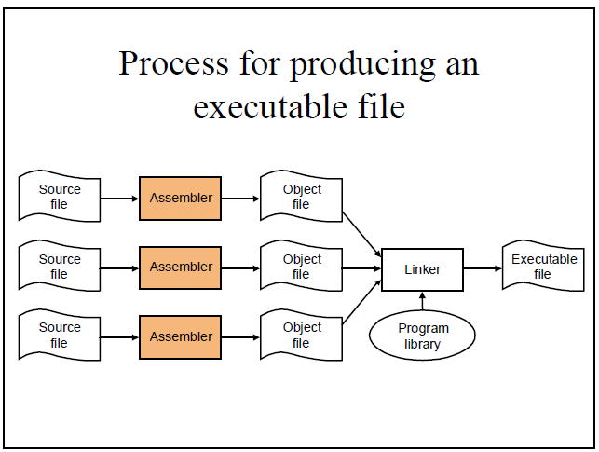

Slide 27
Loader
A loader is a special type of a program that copies programs from a storage device to the main memory, where they can be executed.

Slide 28
Front end and Back end of a Compiler
Front end:
Lexical Analyzer
Syntax Analyzer
Semantic Analyzer
Intermediate Code Generator
Back end :
V. Code Optimizer
VI. Code Generator

Slide 29
Advantages of Using Front-end and Back- end
Retargeting: Build a compiler for a new machine by attaching a new code generator to an existing front-end
Optimization: Reuse intermediate code optimizers in compilers for different languages and different machines.

Slide 30
Symbol Table Management
A symbol table is a data structure containing all the identifiers (i.e. names of variables, procedures etc.) of a source program together with all the attributes of each identifier.
For variables, typical attributes include:
its type,
how much memory it occupies,
its scope.
For procedures and functions, typical attributes include:
the number and type of each argument (if any),
the method of passing each argument, and
the type of value returned (if any).

Slide 31
Symbol Table Management
The purpose of the symbol table is to provide quick and uniform access to identifier attributes throughout the compilation process. Information is usually put into the symbol table throughout the analysis phase and used for the synthesis phase.

Slide 32
Error Handler
Each of the six phases (but mainly the analysis phases) of a compiler can encounter errors. On detecting an error the compiler must:
report the error in a helpful way,
correct the error if possible, and
continue processing (if possible) after the error to look for further errors.

Slide 33
Lecture References
A. Aho, R. Sethi and J. Ullman, Compilers: Principles, Techniques and Tools
(The Dragon Book), [ Second Edition]

Slide 34
References
A. Aho, R. Sethi and J. Ullman, Compilers: Principles, Techniques and Tools(The Dragon Book), [ Second Edition]
Principles of Compiler Design (2nd Revised Edition 2009) A. A. Puntambekar
Basics of Compiler Design Torben Mogensen

